Slide 1
Learning Objective- to write simple instructions.
I can use Imperative verbs ( bossy verbs).
I can use time conjunctions to show the order to do things .
I can use adverbs to describe how to do the different actions.

Slide 3
I would like you to……
Verb | Adverb
jump | quickly
Sit down | slowly
wave | joyfully
smile | creepily
laugh | quietly
sing | badly

Slide 4
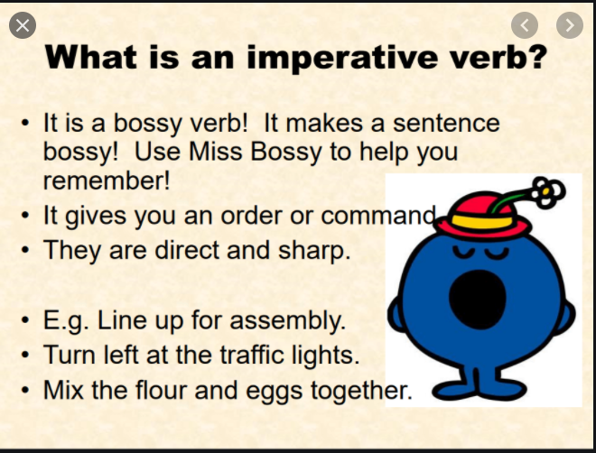
Verbs are doing words
Stand up
Sit down
Wave
Jump
Hop
Laugh
Dab
Smile

Slide 5
Warm up activity
Following instructions.
https://www.youtube.com/watch?v=wZv62ShoStY

Slide 6
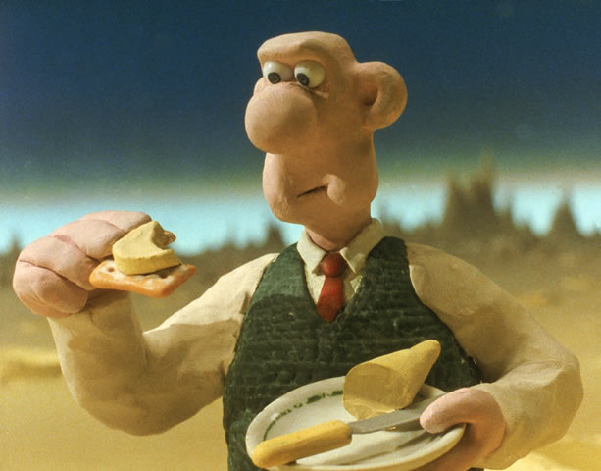
https://www.youtube.com/watch?v=T0qagA4_eVQ

Slide 7
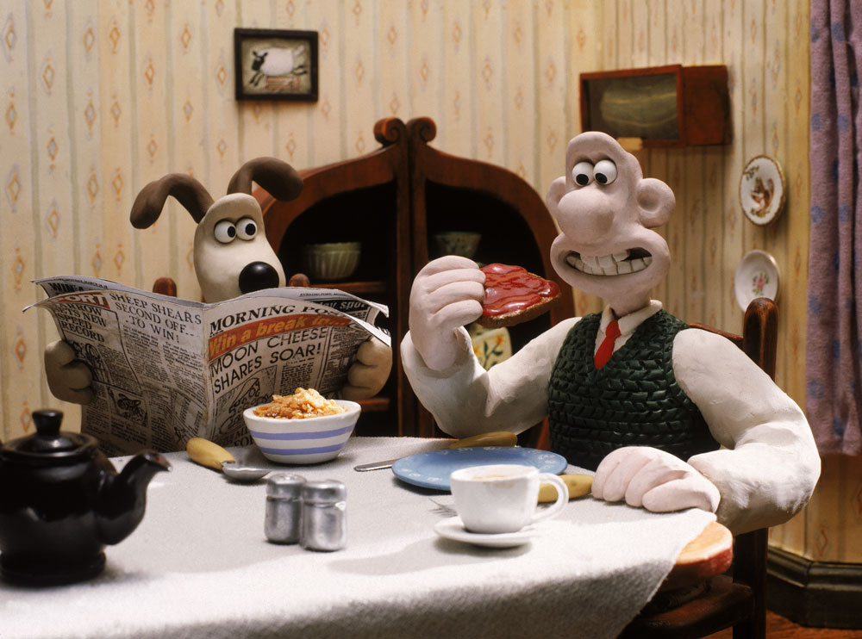
Our Challenge…
We are going to write a set of instructions for Gromit to make Wallace a really lovely cheese sandwich. When they go on your big adventure they will have a delicious lunch to enjoy.

Slide 8
What will we need to make a cheese sandwich?
You will need:

Slide 9
How to make a cheese sandwich
1)
Time Conjunctions
First
Then
Next
After that
Finally…
Adverbs
Carefully
Slowly
Safely
Neatly
Thinly

